Slide 1
Lesson 7 : Hardhat Fund Me

Slide 2
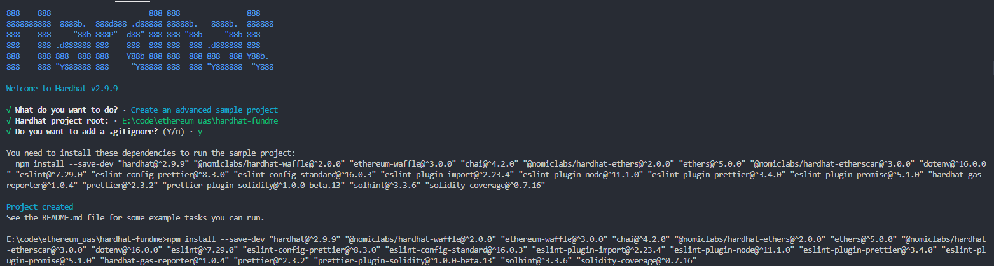
Initial Setup

Slide 3
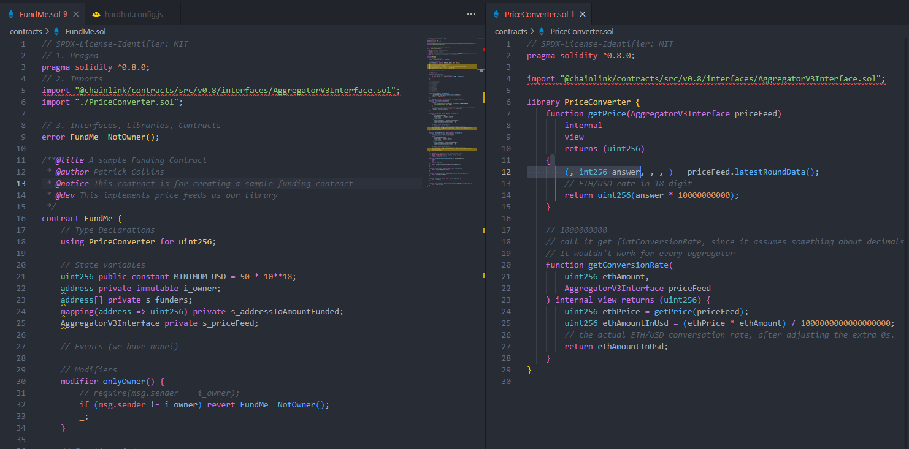
Initial Contracts
Followed source code from: https://github.com/PatrickAlphaC/hardhat-fund-me-fcc

Slide 4
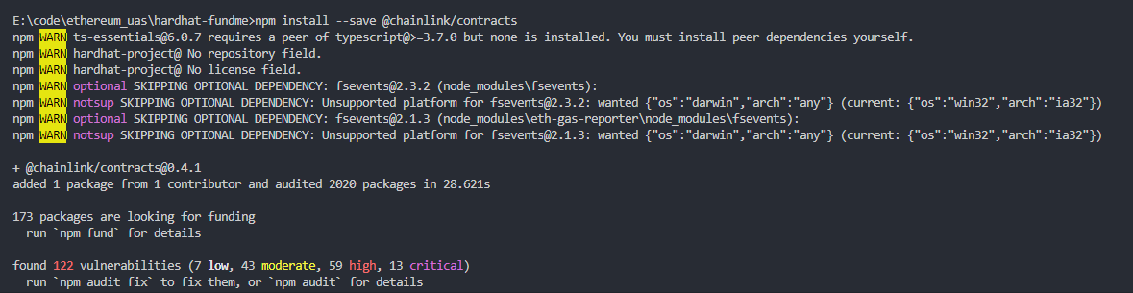
Importing NPM Packages
@chainlinks/contracts

Slide 5

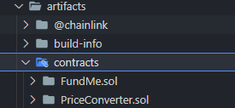
Compiling Contracts
Compiled Results:

Slide 6
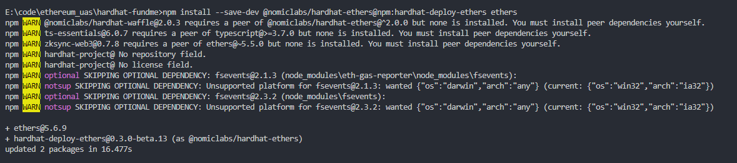
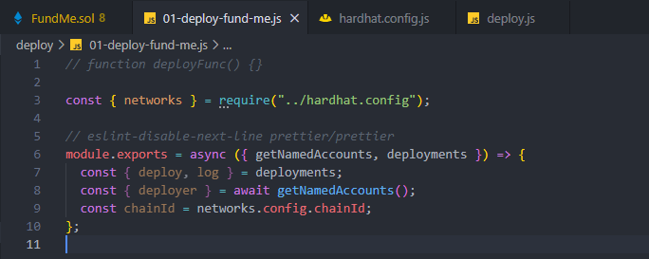
Hardhat Deploy

